Slide 1

Data Modeling with Core Data Services

Slide 2
Day 2

Slide 3
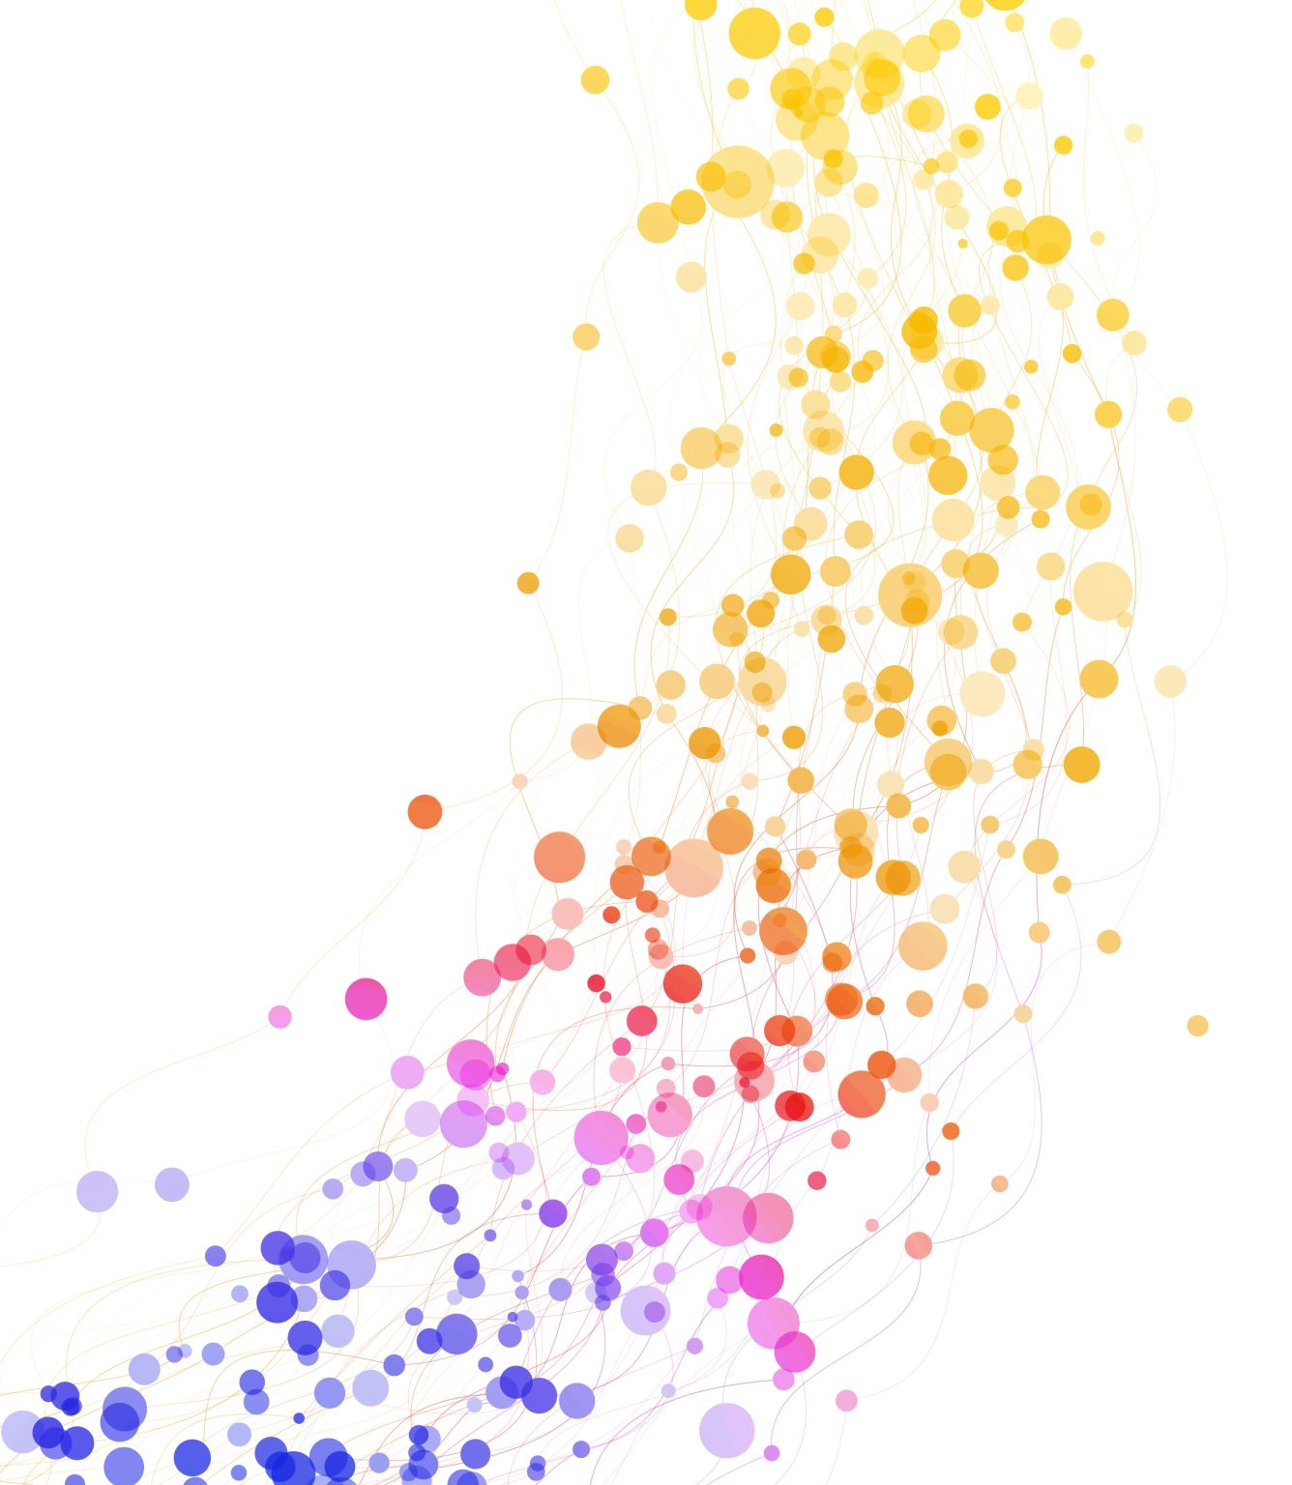
CDS Extension
Practical exercise

Slide 4
Extend SAP (Standard) Views
A CDS view extension can be compared with APPEND STRUCTURE in ABAP Dictionary Table.
Via New > Other Repository Object … > Data Definition
Note the following @AbapCatalog.viewEnhancementCategory:[#...]
#NONE - No extension
#PROJECTION_LIST - Extensions of the SELECT list/additional associations
#GROUPBY- Aggregated or non-aggregated elements
#UNION - Extensions to the SELECT list of a CDS view with a UNION clause

Slide 5
Extend SAP (Standard) Views
Extensions can contain
Literals, fields, expressions, functions, ...
parameters
Associations and paths
Grouping (if the base view group contains by)
UNION

Slide 6
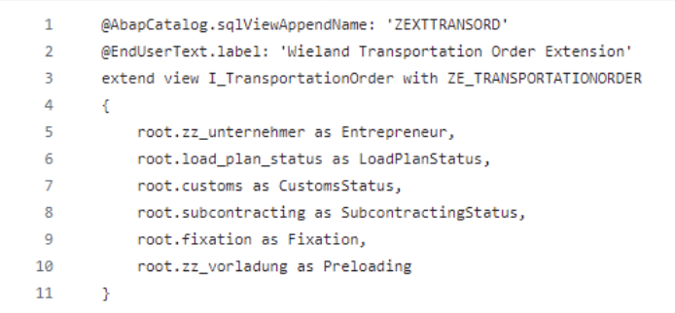
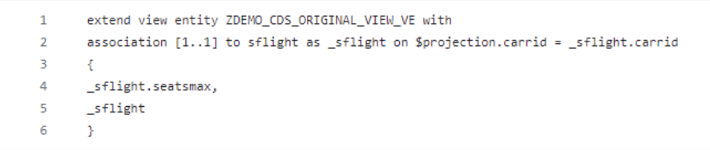
Examples of CDS extensions

Slide 7
Hands On
Create a CDS view and a CDS view entity for the SFLIGHT table.
Extend each of these views with a CDS extension.
Test the CDS using a separate view.
Can you create an extension if no extension category exists?

Slide 8
Consumption Views
Practical exercise

Slide 9
Hands On
Open transaction /UI2/FLP
Log in to client 840
Call up the App Finder
Possibly add the query viewer to the start page
Outlook: own tile / tile for the query

Slide 10
Query Viewer
WebDynpro Data Grid instead of UI5 / Fiori
Available on desktop and tablet devices
Complies with SAP's accessibility standards
Includes a download in PDF format
Provides exception reporting option to define customised field name mappings via BAdI
The filters are displayed in the header area of a data grid app and offer enormous flexibility (no popup)
The navigation panel can be hidden (more space on the screen)

Slide 11
Query Viewer
Jumps are defined via IMG /UI2/SEMOBJ

Slide 12
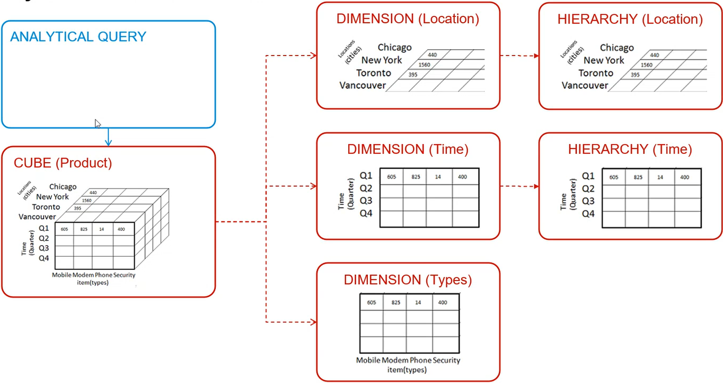
Basic structure of an analytical query

Slide 13
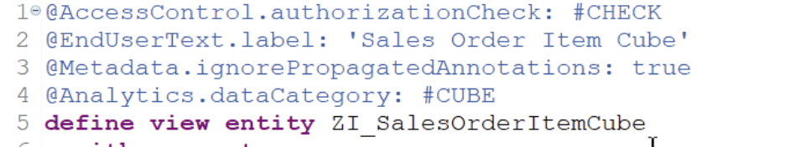
Cube
Without the annotation of the #Cube data category, no projection can be created as an analytical query.

Slide 14
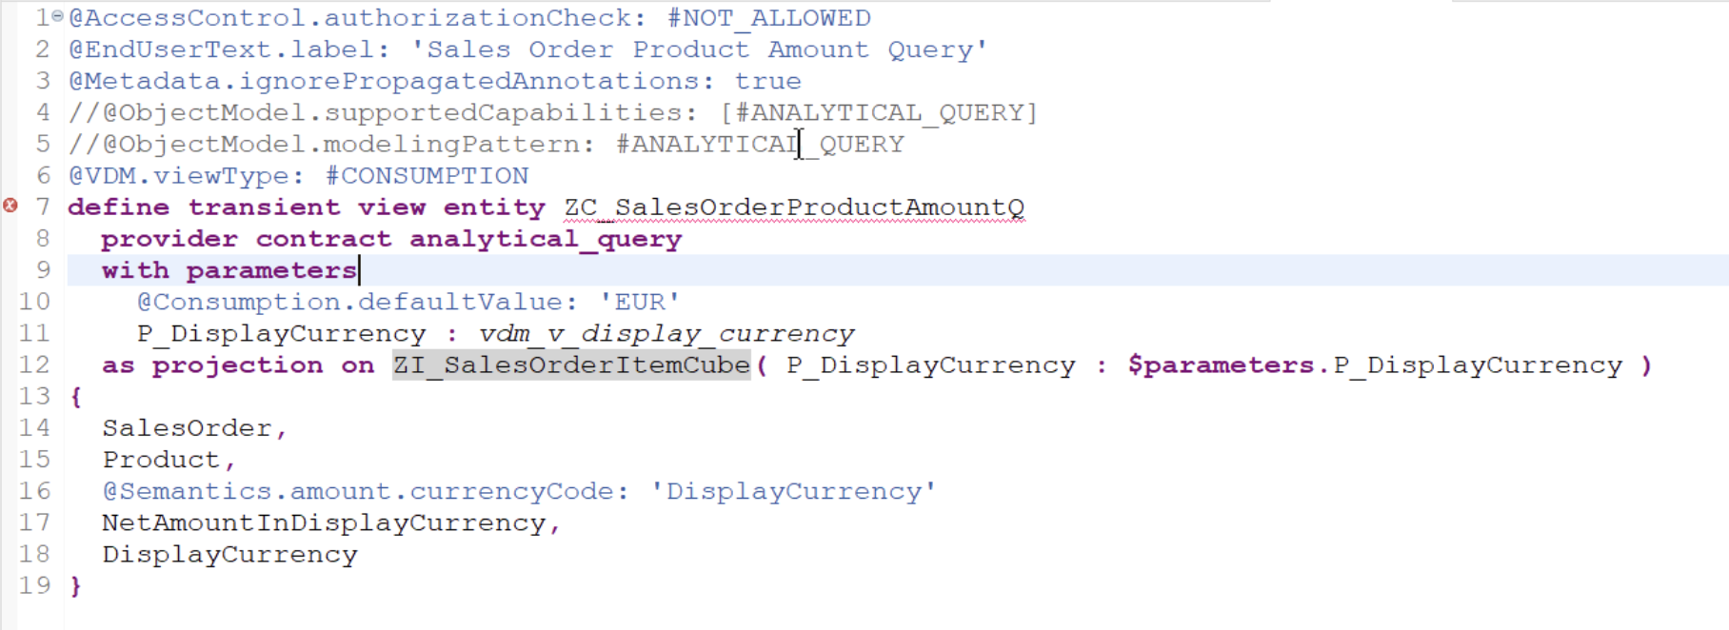
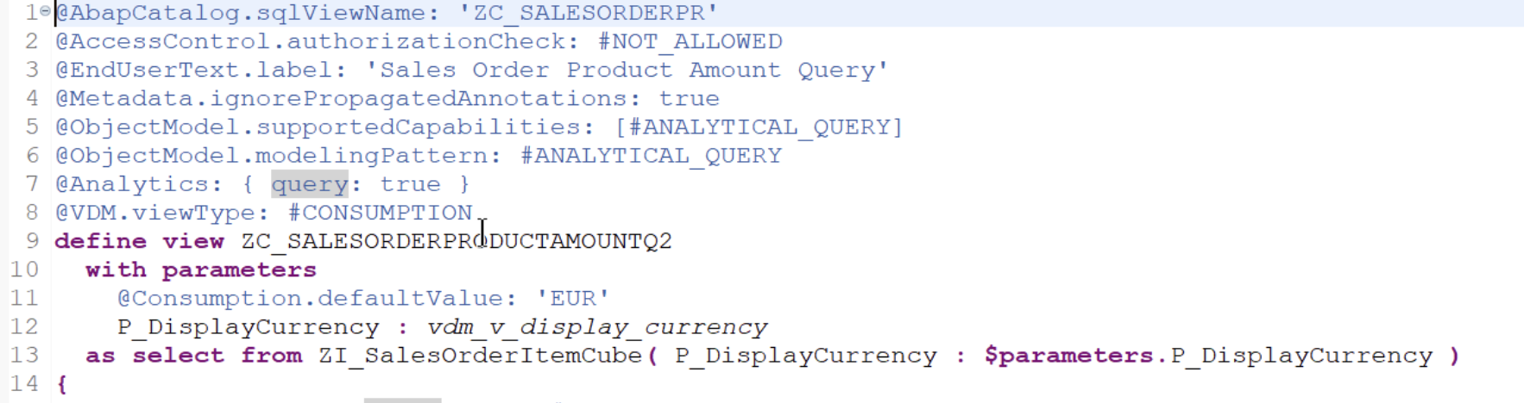
new vs. old

Slide 15
Hands on
Create a view of the data category Cube.
Use the select from the code snippet including associations.
Can you implement the join conditions as associations? Or do you need the associations at all? Use the data preview to help you.

Slide 16
Hands on
Create a Consumption View as a query.
Check this using the Query Viewer.
Are the fields displayed correctly as KPIs / key figures? If not, check the @Semantics

Slide 17
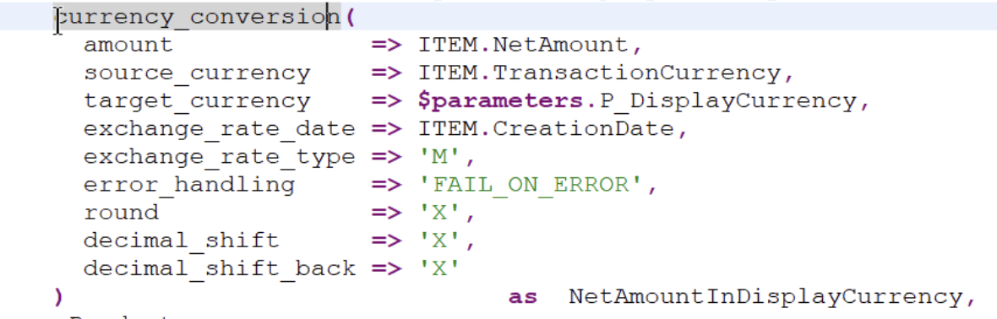
Hands On
Use the CDS function currency conversion in the cube.
Use a parameter of the data type vdm_v_display_currency to pass the currency.
Don't forget to link the currency field using @Semantics.
Does the parameter also have to be specified in the Consumption View?
Add default values: @Consumption.defaultValue: 'EUR'

Slide 18
Hands On
Use the following filter annotation in your Consumption View for four meaningful fields. Use the different selection types.
Open and test the query in the viewer.
Additional task: Do your selection fields have a search help? If not, find out about a possible annotation. Before you implement this, discuss it briefly.

Slide 19
Hands on
Set a default value for a meaningful filter @Consumption: { filter: { selectionType: #SINGLE, multipleSelections: true, defaultValue: '0001' } }

Slide 20
Hands on
Analyse the following coding and use it sensibly in your Consumption View.
Check the meaningfulness of the fields used from the I_LastMonthDate view.
@Consumption: {filter: {selectionType: #INTERVAL}, derivation:{lookupEntity: 'I_LastMonthDate‘, resultElement: 'LastMonthStartDateTime‘, resultElementHigh: 'ABAPMaximumDateTime‘, binding: [{targetElement: 'CalendarDate‘, type: #SYSTEM_FIELD, value: '#SYSTEM_DATE'}]}}

Slide 21
Hands On
What can you use the following annotation for? @EndUserText: { label: 'Warenempänger PLZ', quickInfo: 'Warenempänger PLZ‘ }
Translate the text using SAP Note 2815059 (PDF in GitHub)

Slide 22
Hands On
Find out what the following annotations are for
@AnalyticsDetails.query.axis : #ROWS
@AnalyticsDetails.query.hidden: true
@ObjectModel.foreignKey.association: '_TranspChargeLocalCurrency'

Slide 23
Hands On - Together
Creating a Fiori / Webdynpro Tile for the Fiori Launchpad

Slide 24
Advanced Concepts
Practical exercise

Slide 25
Database Specific Features
AMDP (Table Functions)

Slide 26

AMDP
AMDP (acronym for ABAP Managed Database Procedures) originally referred to an SAP "framework" for defining, implementing, managing and calling database procedures in the SAP HANA database from the ABAP application server. Support for database functions has now also been added. The implementation takes place in SQLScript, the query language for the SAP HANA database.
^{Quelle Wikipedia}

Slide 27
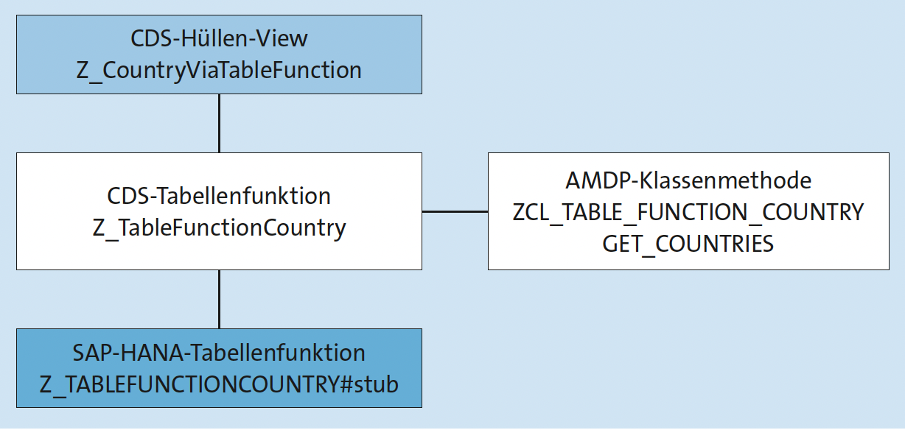
Structure AMDP
CDS View dient als Wrapper
Table Function muss durch Methode implementiert werden.

Slide 28
AMDP
Example of use in standard CL_CS_BOM_AMDP
In the AMDP class method, IF_CS_BOM_AMDP must be specified as the interface.

Slide 29
Hands On
Create a table function with parameters (as data definition). Use a name similar to Z_TableFunctionCountry.
Use a parameter @Environment.systemField: #CLIENT P_SAPClient : vdm_v_sap_client
Define the following fields
mandt : vdm_v_sap_client;
Country : land1_gp;
CountryThreeLetterISOCode : intca3;
CountryThreeDigitISOCode : intcn3;
CountryISOCode : intca;
CountryCurrency : waers_005;
IndexBasedCurrency : curin;
HardCurrency : curha;
TaxCalculationProcedure : kalsm_d;

Slide 30
Hands On
Implement an AMDP class
Use ZCL_TABLE_FUNCTION_COUNTRY as a template

Slide 31
Hands On
Create a view entity as a select on the table function you created. Don't forget the parameter.

Slide 32
Hands On
Use another or a different transfer parameter.

Slide 33
Hands On
Add the following associations to your entity view:
0..* for I_CountryText
0..1 for I_Currency
Display the associated text.
Use I_Currency for a foreign key association.

Slide 34
Consuming CDS views
ALV IDA and OData

Slide 35
Hands On
ALV IDA

Slide 36
OData
The Open Data Protocol (OData) is an HTTP-based protocol published under Microsoft's Open Specification Promise for data access between compatible software systems in order to enable CRUD operations in these systems. Building on older protocols such as ODBC and JDBC, OData can be integrated within cloud services (Azure), MySQL, Java and Rails, among others, and is able to provide standardised semantics for data exchange in client-server communication. ^{Quelle Wikipedia}

Slide 37
Hands On
Implement the source code from the GIT

Slide 38
Hands On - Gemeinsam
Creating a simple OData service
Important transaction: /IWFND/V4_Admin

Slide 39
Quiz
What do I have to consider with different consumers regarding annotations?
How do I translate texts for end users?
Which objects do I need for AMDP / table functions?
What extension categories are there?
What is the name of the transaction for the FIORI Launchpad?
What is the name of the transaction for publishing an OData service in local or productive systems?
What are the minimum objects I need to create for an OData service?
What is the basic structure for analytical queries?
How is the order of the fields in a query determined?

